Slide 1


Adventureworks Sales Performance Report: 2001-2004
Focusing on Online vs. Offline Sales, sales performance, Trends, and Customer Retention

Slide 2
Key Objective: Providing data-driven insights to optimize sales strategies and performance

Slide 3
Agenda
Yearly Sales-trend overview
Salesperson performance over the years
Overview of Online and Offline Sales Trends
Revenue and Order Analysis
Sales performance by product
Geographic Sales Patterns
Customer Retention Insights
Actionable Recommendations for Sales Optimization

Slide 4
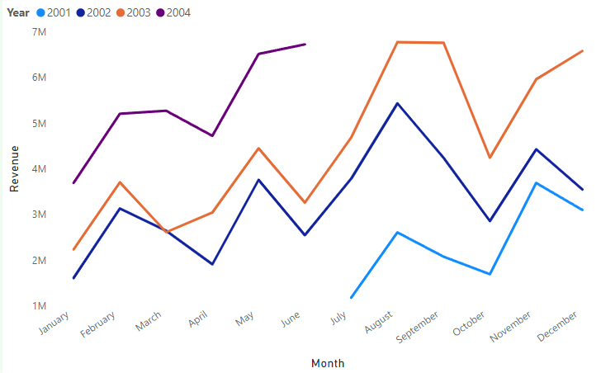
Yearly Sales-trend overview
There is an overall upward trend in sales revenue over the years with August and November consistently showing significant increases in sales across all years.

Slide 5
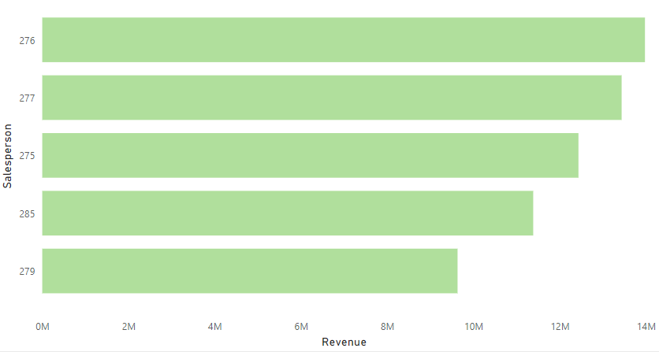
Salesperson performance over the years
“Salesperson ‘276’ significantly outperformed peers in revenue generation from 2001 to 2004.”
Consider exploring the strategies or territories used by ‘279’ to share actionable insights with the team.

Slide 6
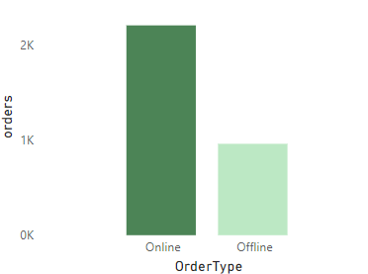
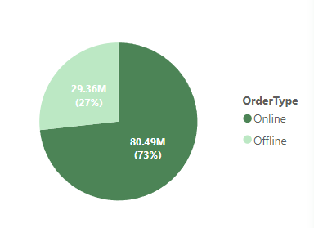
Overview of Online and Offline Sales Trends
Count of orders by order-type
Revenue generated by ordertype
Our online orders not only dominate in terms of quantity but also drive higher revenue. This underscores the importance of our digital channels and suggests that investing in online customer experience and marketing strategies can yield substantial returns

Slide 7
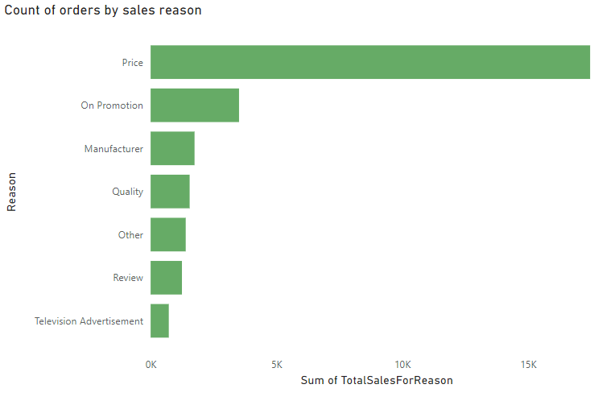
Revenue and Order Analysis
Price Sensitivity: The most significant factor influencing sales orders is price. Customers appear to be highly price-sensitive.
Advertising Impact: Interestingly, television advertisements seem to have the least influence on generating sales orders.
Strategic Implications: Adventureworks should focus on pricing strategies and explore alternative advertising channels beyond television

Slide 8
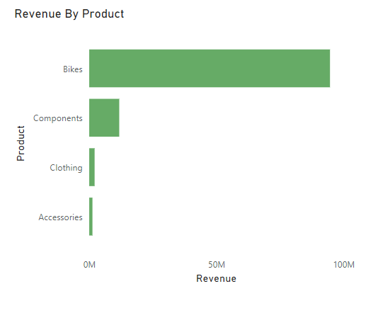
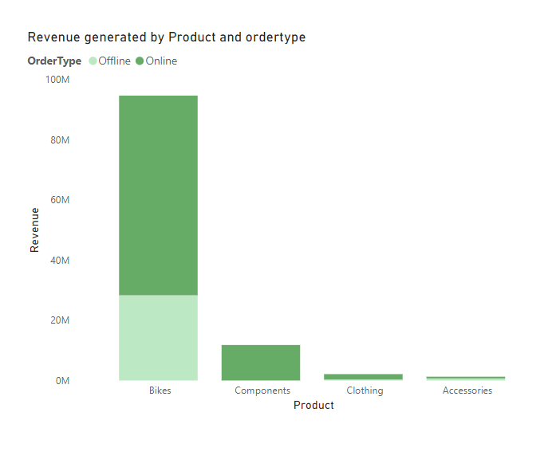
Sales performance by product
The revenue from bikes significantly outpaces that from other product categories (Components, Clothing, and Accessories).
Generally, most products are being ordered online than offline.

Slide 9
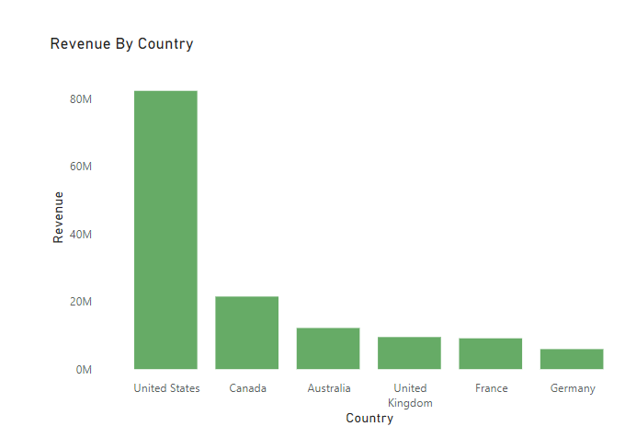
Geographic Sales Patterns
There is a strong concetration in revenue generation in United States than any other country

Slide 10
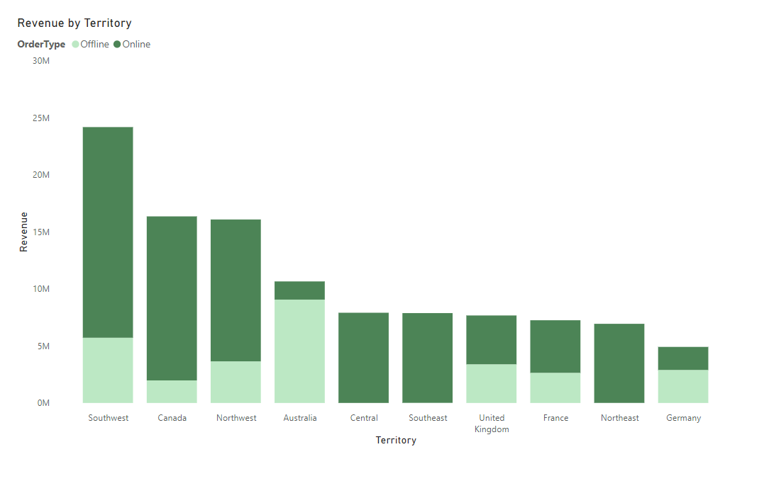
Geographic Sales Patterns
The Southwest territory leads by a large margin, especially in offline orders.
Canada and Northwest are the next strongest contributors with a similar online-heavy split.
Australia stands out for having a higher share of offline revenue.

Slide 11
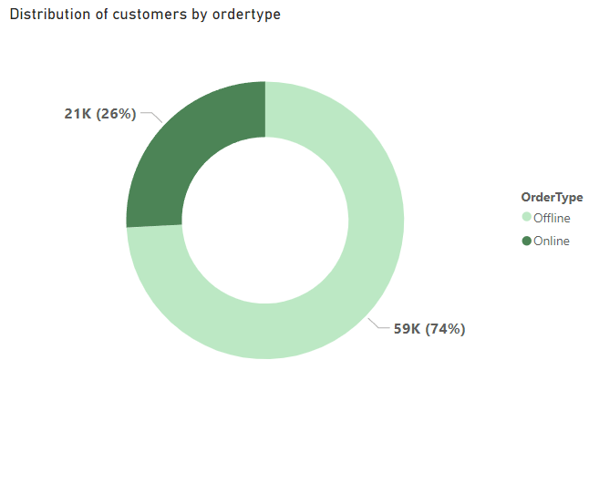
Customer Retention Insights
Majority of Customers Use Offline Channels: The chart shows that 74% of customers (59,000) prefer offline order types, indicating that most customers are interacting through traditional, in-person channels.
Previously, we saw that online orders are higher in terms of count and revenue generation.
This proves to us that the customers who prefer online orders, purchase more products that are of high value than the customers who purchase through offline channels.

Slide 12

Recommendations
Provide additional training and support to underperforming sales teams to equip them with the skills and knowledge to improve sales performance.
Tailor Sales Strategies to Geographic Patterns: Identify regions where offline sales dominate and invest in local outreach efforts or partnerships to boost sales. Similarly, expand online sales strategies in regions showing strong digital sales performance, potentially exploring targeted online advertising or improving digital presence.
Develop marketing campaigns tailored to each country’s and territory’s preferences and needs.

